Slide 1
A Resource for Collocation Teaching, Learning, and Translation
Jurgita Vaičenonienė
Jolanta Kovalevskaitė
Erika Rimkutė

Slide 2
Developed materials:
Resource book: https://arka.pastovu.vdu.lt/wp-content/uploads/2022/07/Mokomoji-priemone.pdf
Accompanying website: https://resursai.pastovu.vdu.lt/mokomoji-priemone/apie

Slide 3
Objectives and topics
The resource contributes to the teaching, learning, and translation of collocations in Lithuanian.
Topics discussed:
Chapter 1:
collocations vs. multiword units;
identification/ selection of collocations for language learning purposes;
tools and resources for collocation description and analysis;
collocation structure, use, and variation.
Chapter 2:
cross-cultural language variation and equivalence;
collocations as a unit of translation;
collocation related translation problems;
freely available language resources and tools for collocation translation and research.

Slide 4
Applications
Study fields:
Language teaching and learning (secondary and higher education)
Translation studies
Linguistics
Use:
Integration of the relevant chapters/ exercises into curriculum/ lectures
Inspiration for exercise adaptation and their extension to other language pairs
Self-study
<...>

Slide 5
CLARIN content
References to the CLARIN infrastructure and language resources (e.g.,VLO, Resource Families);
Self-study activities which include the use of resources and tools offered by CLARIN (Example 1);
Application of the Lithuanian language resources available via CLARIN-LT repository:
exercises developed or data extracted for students to use (Example 2);
learners are encouraged to go to repository/ databases to perform activities or check the answers (Example 3).

Slide 6
Integrated Lithuanian language resources and tools stored at CLARIN-LT repository
Colloc -- A Tool for Automatic Identification of Multiword Expressions. http://hdl.handle.net/20.500.11821/32.
Corpus of the Contemporary Lithuanian Language. http://hdl.handle.net/20.500.11821/16.
DELFI.lt corpus. http://hdl.handle.net/20.500.11821/30.
ORVELIT v3. http://hdl.handle.net/20.500.11821/40.
The Database of Lithuanian Multiword Expressions. http://hdl.handle.net/20.500.11821/49.

Slide 7
Study outcomes
The readers will:
gain knowledge about and be able to use open access resources important for collocation teaching, learning, and translation;
know how to develop collocation learning/ teaching competence individually;
apply various methods for cross-cultural comparison and translation of collocations.

Slide 8
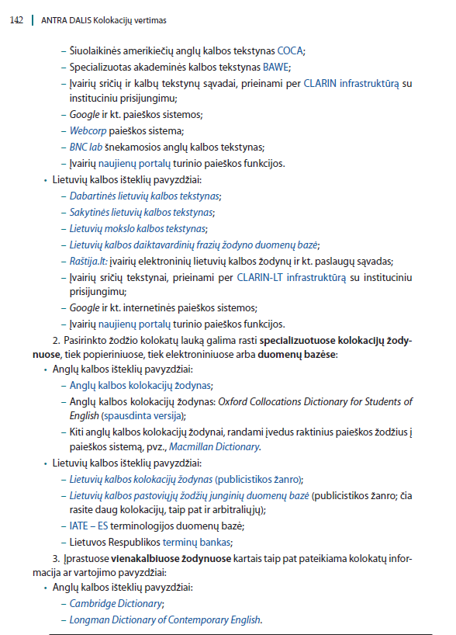
Example 1: Task 4.9
Application of e-resources for metaphorical collocation translation:
Get acquainted with the resources listed in this chapter that can help you translate metaphorical collocations.
Choose one resource and present it in more detail. Discuss the advantages and disadvantages of the resource as a reference source in metaphor translation.
Select 10 collocations from the PASTOVU database and describe their translation process (LT-EN).
Make a list of collocation databases, dictionaries, or other resources not mentioned in the chapter.
Develop translation procedure of metaphorical collocations that you find the most efficient.
Present your project in class.

Slide 9
Example 2: Task 3.11
Find the collocates of the abstract nouns heart, hope, and idea in original and translated popular science texts (source: ORVELIT corpus). Note that it will be easier to compare the data if you remove ‘noise’ from the concordance lines.
Do the collocates of the abstract nouns differ in original Lithuanian texts and those translated from English?
Can the differences be induced by English language interference or may be a result of the content differences of original and translated data? How could your statements be supported?
Notes:
To analyse other words or genres, you can download the corpus from the CLARIN-LT repository.
If you use AntConc software to analyze the data, you may watch this tutorial (link for download).
If you do not have a lot of time for the task, you may analyse the first 50 or 100 occurrences.
Data (access: https://resursai.pastovu.vdu.lt/atsisiusti#konkordansai):
IDEA_original pop sci.txt
IDEA_translated pop sci.txt
HEART_ original pop sci.txt
HEART_ translated pop sci.txt
HOPE_ original pop sci.txt
HOPE_ translated pop sci.txt

Slide 10
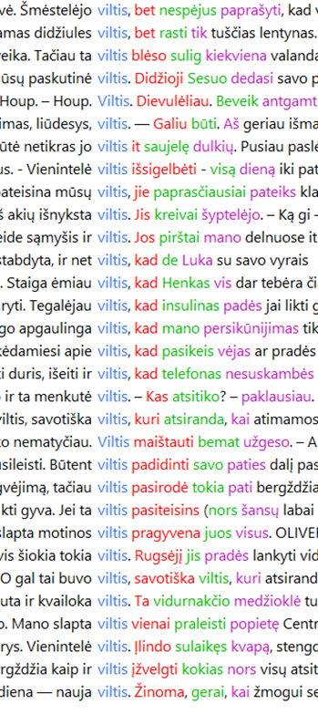
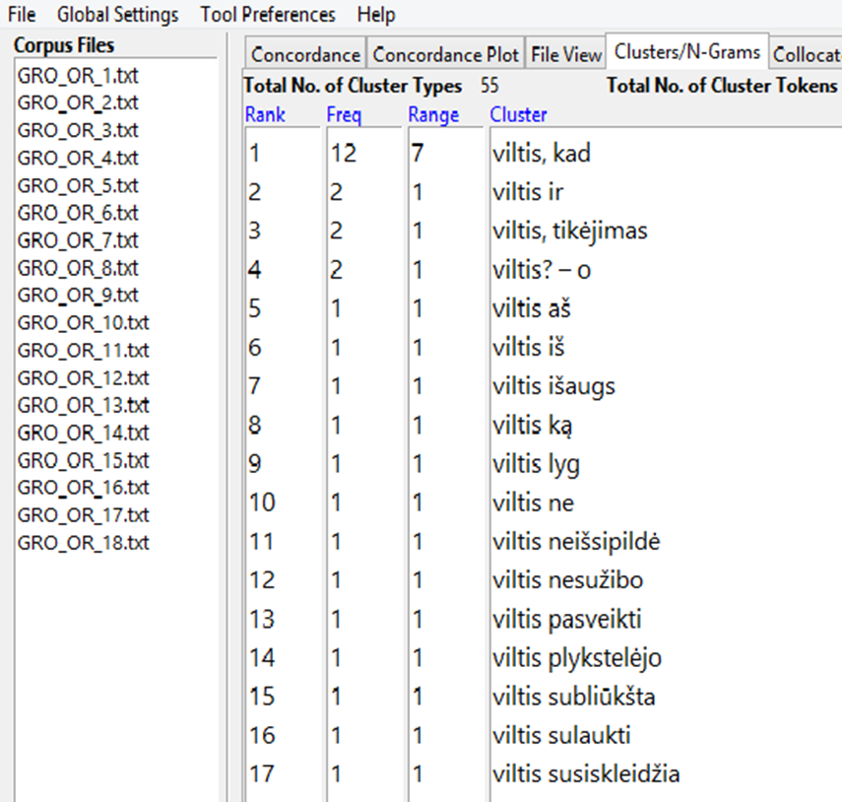
Translated fiction (EN-LT) (approx. 1 mln. tokens); node: hope (nom.); raw hits: 31
Original Lithuanian fiction (approx 1 mln. tokens); raw hits: 69

Slide 11
Example 3: Task 3.12
Choose a text and its translation (e.g. news portals in different languages, your own translations, etc.).
Upload the original text or website link to Voyant Tools text analysis and visualization software and explore different data visualization functions: Cirrus, Links, TermsBerry.
Do the same with the translation of the text. Compare the diagrams for the selected collocations and discuss the similarities and differences between the collocates of selected words in original and translated texts.
Software: https://voyant-tools.org/
Instructions: https://voyant-tools.org/docs/#!/guide/start
Data suggestions:
National Geographic Magazine (EN / LT)
Websites of shops, companies, universities, government organizations (LT / EN)

Slide 12
ST and TT comparison
Source: Gyvas atodūsis. Lietuvių poezijos vertimai. Breathing Free. Poems from the Lithuanian. Editor and Translator: V. Bakaitis. 2001. Vilnius: LRLS.
Rugiagėlės (Kazys Binkis)
Vien tik mėlyna akyse, –
Žemėj, ore ir danguj
Daugiau nieko nebmatysi, –
Vien tik mėlyna akyse...
Užsimerksi, pamąstysi,
Nusijuoksi... O paskui –
Vien tik mėlyna akyse, –
Žemėj, ore ir danguj.
Cornflowers
Blue is all there is to see:
Earth, air and sky;
With nothing more before your eyes,
Blue is all there is to see,
Squint both eyes shut and think,
You'll have to laugh for, all the while,
Blue is all there is to see:
Earth, air and sky.

Slide 13
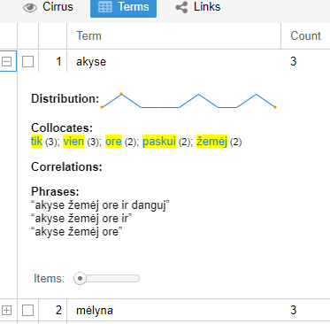
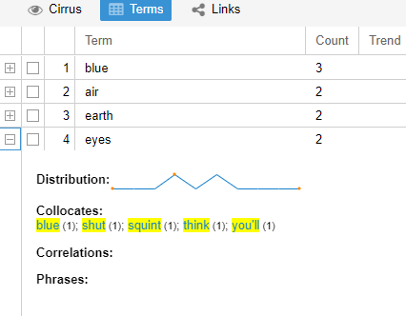

Slide 14
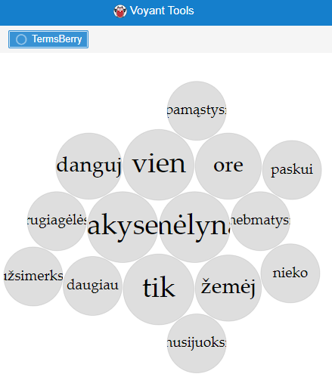
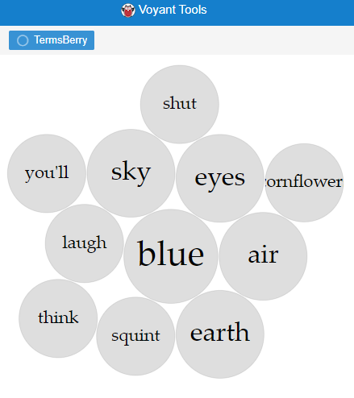

Slide 15
Summing up
Hopefully, the presented resources:
will be used as open access educational materials for the lesser-used Lithuanian language;
encourage the readers to use, adapt, and further develop the exercises for different language pairs and educational needs;
promote the use of the mono- and multilingual corpora for translation and language learning purposes.

Slide 16
Dėkui / Thank you

